Slide 1
Psychoacoustically-Informed Adversarial Attacks on Speech Recognition Systems
Tomer Erez, Technion, February 2025

Slide 2
Introduction
Problem Statement: Speech recognition systems are vulnerable to adversarial attacks.
Objective: Develop imperceptible perturbations on Speech recognition systems.
Key Concept: Leverage psychoacoustic principles to hide adversarial noise from human listeners.
Notes:
psychoacoustic principles :
human auditory masking :

Slide 3


Applications
Smart Devices :(e.g., Voice Assistants, Siri, Alexa).
Smart Homes and IoT Systems:(Prevent adversarial commands from altering home automation e.g., "turn off alarm," "open door").
Transcription services: defend or attack speech-to-text transcriptions(medical, legal).

Slide 4
My research
Adversarial Attacks in Audio: Overview of past audio attack methods (CW, FGSM, PGD, PGDTRIM).
Addition of psychoacoustic constraints on perturbations
Focus on universal, untargeted attacks
Addition of my new attack methods

Slide 5
psychoacoustic principles: making an imperceptible perturbation for the human ear.
principle | explained | How to leverage
Spectral Masking | A loud sound at a particular frequency can "mask" nearby frequencies. | hide quieter sounds in the same frequency of the speaker loud frequencies.
Temporal Masking | A sound immediately before or after a loud sound can be imperceptible | Find these points in time and immediately perform noise
Frequency Sensitivity | Humans are less sensitive to frequencies outside of the speech frequency (2kHz to 4kHz) | Place perturbations in frequency ranges where humans have reduced sensitivity (e.g., below 500 Hz or above 8 kHz) to remain imperceptible.
Auditory Time Slicing | The human brain processes sounds in small "chunks" of time (~10–20 ms). | Inject short, imperceptible bursts of noise (within 10 ms intervals) that disrupt the model’s input but do not register as separate sounds to human listeners.
Critical Bands/bands quantization | human auditory system processes sounds in "bands" of frequencies rather than individual frequencies, | Add perturbations at frequencies that are not in the same band to avoid detection.
JND: Just Noticeable Difference | the smallest change in a stimulus (e.g., sound intensity, frequency, or duration) that a human listener can detect. For audio, JND thresholds vary with frequency (e.g., ~1 dB for loudness, ~0.5% for frequency) | Changes below the JND are imperceptible to humans and can be used to hide adversarial perturbations.

Slide 6
psychoacoustic principles to perturbations constraints, motivations for the model
Bound the perturbation with JND! (reminds us of the norm constraints from vision attacks
Increase loss for detectable sounds
Decrease for undetectable sounds
Apply constraint on the perturbation to adhere to psychoacoustic principles
Read ARTICLES and how they did it

Slide 7
Training algorithm for Generating Psychoacoustic Perturbations
Key Points:
Input Audio + Perturbation:
Original clean speech sample x.
Add perturbation δ such that the new audio x′=x+δ.
STFT/ISTFT Preprocessing:
STFT (Short-Time Fourier Transform): Converts the waveform into time-frequency representation (spectrogram).
Add perturbations to specific frequency bins using psychoacoustic constraints.
ISTFT (Inverse STFT): Convert perturbed spectrogram back to time-domain waveform x′.
Model Input:
Feed x′ (perturbed audio) into the speech recognition model (e.g., Whisper, Wav2Vec 2.0).
predict result y′ and compare it with the original transcription y.
Loss Function:
CTC Loss (Connectionist Temporal Classification): Optimizes the perturbation to maximize the transcription error.
Norm Constraints: Enforce imperceptibility using psychoacoustic thresholds (e.g., keep perturbations within Just Noticeable Difference (JND) limits).
Optimization Loop:
Minimize loss by adjusting the perturbation δ.
Ensure perturbations remain subtle (under psychoacoustic limits).

Slide 8
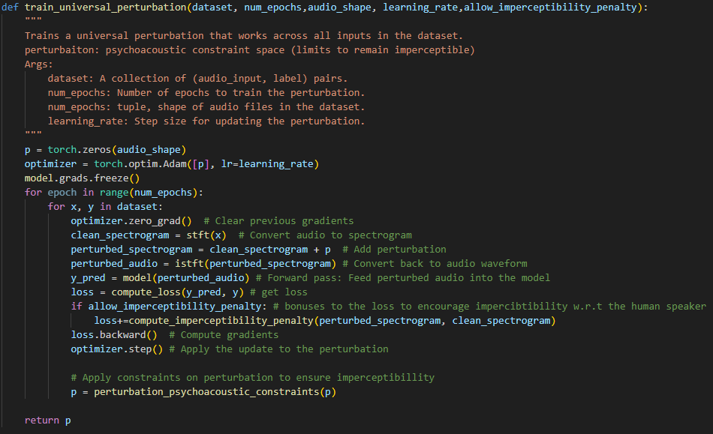

Slide 10
<<<original_sound>>>.mp4
<<<trained_perturbation>>>.mp4
<<<sound_with_perturbation>>>.mp4 (which is the model input)

Slide 11
Evaluation Results on Different ASR Models
Models Tested:
Whisper (OpenAI)
Wav2Vec 2.0 (Meta)
DeepSpeech (Mozilla)
Dateset:
Metrics for Comparison:
Word Error Rate (WER): Measure the accuracy of the transcription before and after perturbation.
Signal-to-Noise Ratio (SNR): Quantify the level of perturbation relative to the original speech.
PESQ (Perceptual Evaluation of Speech Quality): Evaluate audio quality after perturbation from a perceptual standpoint.
Graphs/Tables:
Plot WER across different models for varying levels of perturbation ϵ\epsilonϵ.
Show a table comparing PESQ scores and SNR for different psychoacoustic constraints (e.g., temporal vs. spectral masking).
Observations:
ASR models are highly sensitive to targeted perturbations in specific frequency bands.
Some models (e.g., Whisper) are more robust due to diverse training data.

Slide 12
Summary and Future Directions
Summary:
Psychoacoustic principles (masking, JND) can effectively hide adversarial noise.
Perturbations designed with psychoacoustic constraints can trick ASR systems while remaining imperceptible to humans.
The framework was evaluated on multiple ASR models with varying levels of robustness.
Challenges:
Ensuring perturbations remain imperceptible across different environments.
Computational complexity of STFT/ISTFT-based attacks.
Future Work:
Implement real-time perturbation generation for practical deployment.
Explore defenses, such as adversarial training with psychoacoustic noise augmentation.
Investigate multi-channel (binaural) attacks using spatial perturbations.
Test perturbations under real-world conditions (e.g., reverberation, background noise).

